Slide 1

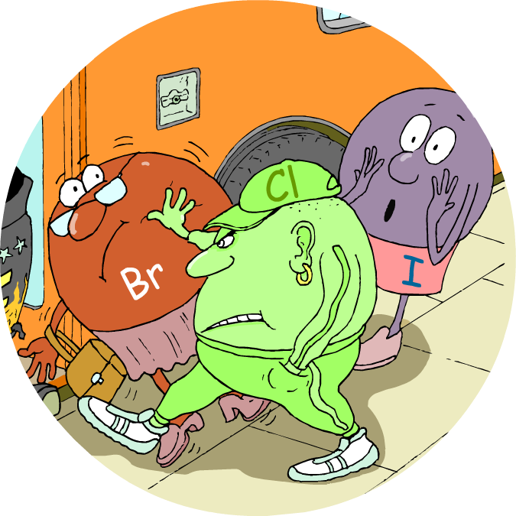

HALOGENS

Slide 2
Electron structure and reactivity

Slide 3
Group 7 – the halogens
Halogens are in group 7 of the periodic table, on the right.
7
H
He
Li
Be
B
C
N
O
F
F
Ne
Na
Mg
Al
Si
P
S
Cl
Cl
Ar
K
Ca
Sc
Ti
V
Cr
Mn
Fe
Co
Ni
Cu
Zn
Ga
Ge
As
Se
Br
Br
Kr
Rb
Sr
Y
Zr
Nb
Mo
Tc
Ru
Rh
Pd
Ag
Cd
In
Sn
Sb
Te
I
I
Xe
Cs
Ba
La
Hf
Ta
W
Re
Os
Ir
Pt
Au
Hg
Tl
Pb
Bi
Po
At
At
Rn
Fr
Ra
Ac
Rf
Db
Sg
Bh
Hs
Mt
Ds
Rg
?
?
?
?
?
?
?

Slide 4
Electron structure
All halogens have 7 electrons in their outer shell.
This means that:
fluorine
2,7
They can easily obtain a full outer shell by gaining 1 electron.
chlorine
2,8,7
They all gain an electron in reactions to form negative ions with a -1 charge.
They have similar chemical properties.
bromine
2,8,8,7

Slide 5
Electron structure and reactivity
All halogens are reactive, and the reactivity decreases down the group. What is the reason for this?
The size of each element’s atoms, and the number of full electron shells, increases down the group.
F
This means that, down the group, the outer shell gets further away from the nucleus and is shielded by more electron shells.
Cl
decrease in reactivity
Br
The further the outer shell is from the positive attraction of the nucleus, the harder it is to attract another electron.
I
This means that reactivity decreases with the size of the atom.

Slide 6
Halogen molecules
All halogen atoms require one more electron to obtain a full outer shell and become stable.
Each atom can achieve this by sharing one electron with another atom to form a single covalent bond.
F
+
F
➔
F
F
This means that all halogens exist as diatomic molecules: F₂, Cl₂, Br₂ and I₂.

Slide 7
Physical properties

Slide 8
General properties
All halogens are:
non-metals and so do not conduct electricity;
brittle and crumbly when solid;
poisonous and smelly.
They become darker in colour down the group:
fluorine is pale yellow
chlorine is green-yellow
bromine is red-brown
iodine is blue-black

Slide 9
Physical state of halogens
The melting and boiling points of halogens increase down the group, as the molecules become bigger.
Halogen
Relative size
Melting point (°C)
Boiling point (°C)
State
fluorine
-220
-118
gas
chlorine
-101
-34
gas
bromine
-7
59
liquid
iodine
114
184
solid
What is the state of each halogen at room temperature?

Slide 10
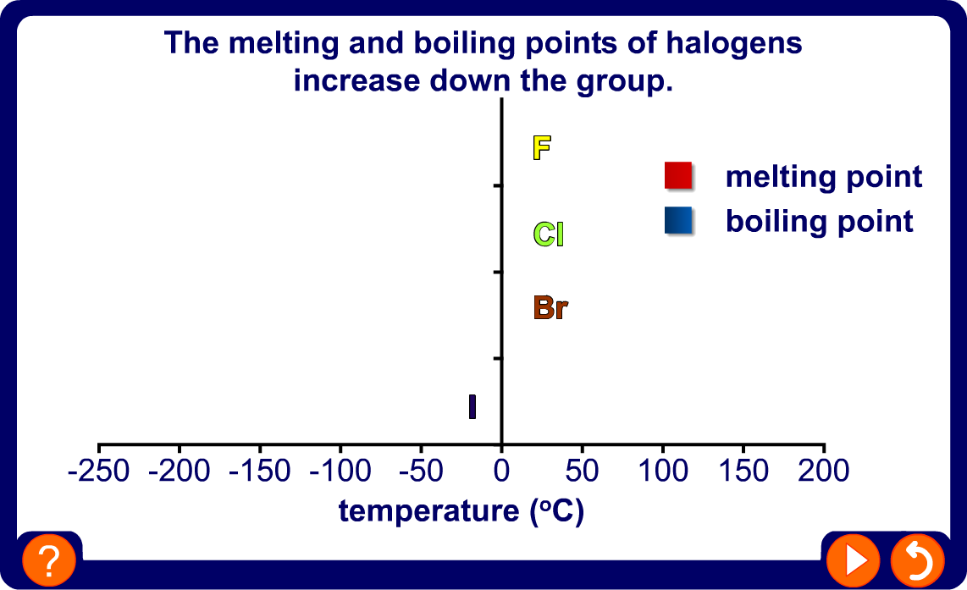
Melting and boiling points of halogens

Slide 11

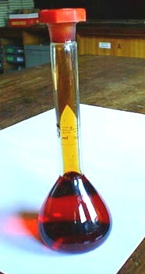

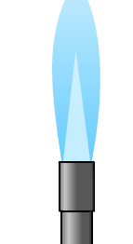
Halogen vapours
Bromine and iodine are not gaseous, but have low boiling points. This means that they produce vapour at relatively low temperature. They are volatile.
When iodine is heated gently, it changes directly from a solid to a gas without first becoming a liquid.
Bromine produces a red-brown vapour.
This is called sublimation.

Slide 12
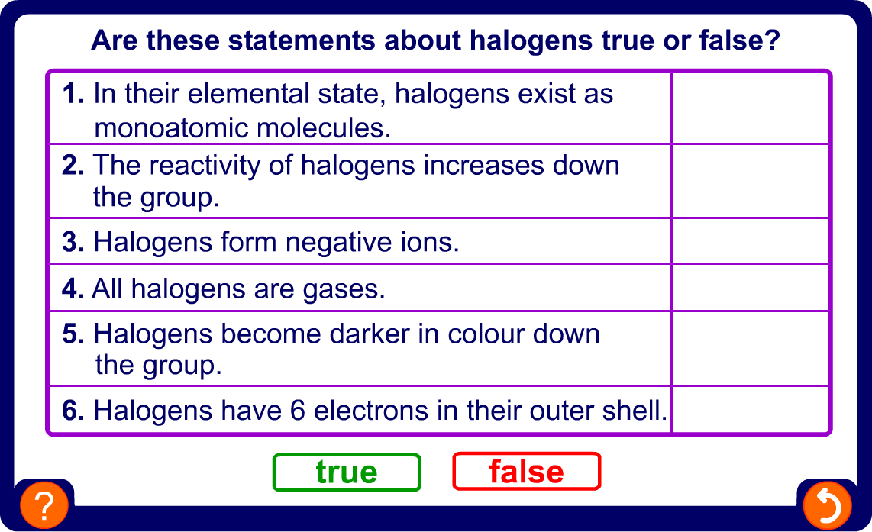
True or false?

Slide 13
Reactions

Slide 14
Reactivity of halogens
The reactivity of halogens decreases down the group. This can be demonstrated by comparing how they react with hydrogen.
Halogen
Reactivity with hydrogen
fluorine
Reacts instantly, even at -200 °C.
decrease in reactivity
Reacts slowly in the dark. Explodes in the light.
chlorine
bromine
Needs heating to +200 °C in order to react.
iodine
Does not react completely, even at 500 °C.
Astatine is the halogen that appears directly below iodine in the periodic table. How do you think astatine would react with
hydrogen?
Notes:
Teacher Notes
Astatine is a rare, radioactive element that has a half-life of only 8 hours.

Slide 15
Halides
When halogens react with another substance, they become ions. When this happens, they are called halides.
The name of the halogens change slightly once they have reacted – instead of ending with ‘–ine’, they end with ‘-ide’.
Halogen
reaction
Halide
fluorine
(F)
fluoride
(F )
-
chlorine
(Cl)
chloride
(Cl
-
)
bromine
(Br)
bromide
(Br
-
)
iodine
(I)
iodide
(I
-
)

Slide 16
Displacement reactions
If a halogen is added to a solution of a compound containing a less reactive halogen, it will react with the compound and form a new one. This is called displacement.
+
sodium chloride
sodium fluoride
+
fluorine
➔
chlorine
F₂ (aq)
+
2NaCl (aq)
➔
2NaF (aq)
+
Cl₂ (aq)
A more reactive halogen will always displace a less reactive halide from its compounds in solution.

Slide 17
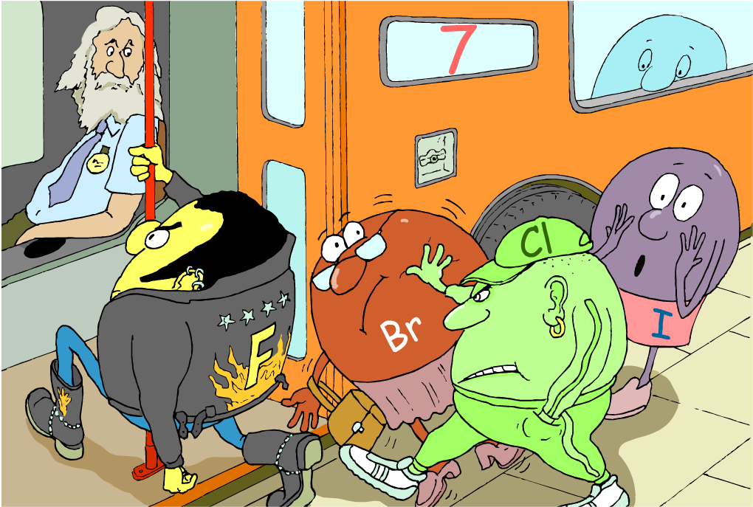
Displacement of halogens
Why will a halogen always displace a less reactive halogen?

Slide 18
Displacement theory
If a metal halide is mixed with a more reactive halogen, the extra electron will be transferred from the less reactive to the more reactive halogen.
-
+
sodium
chloride
chlorine
Na
Cl
Cl
-
fluorine
F
fluoride

Slide 19
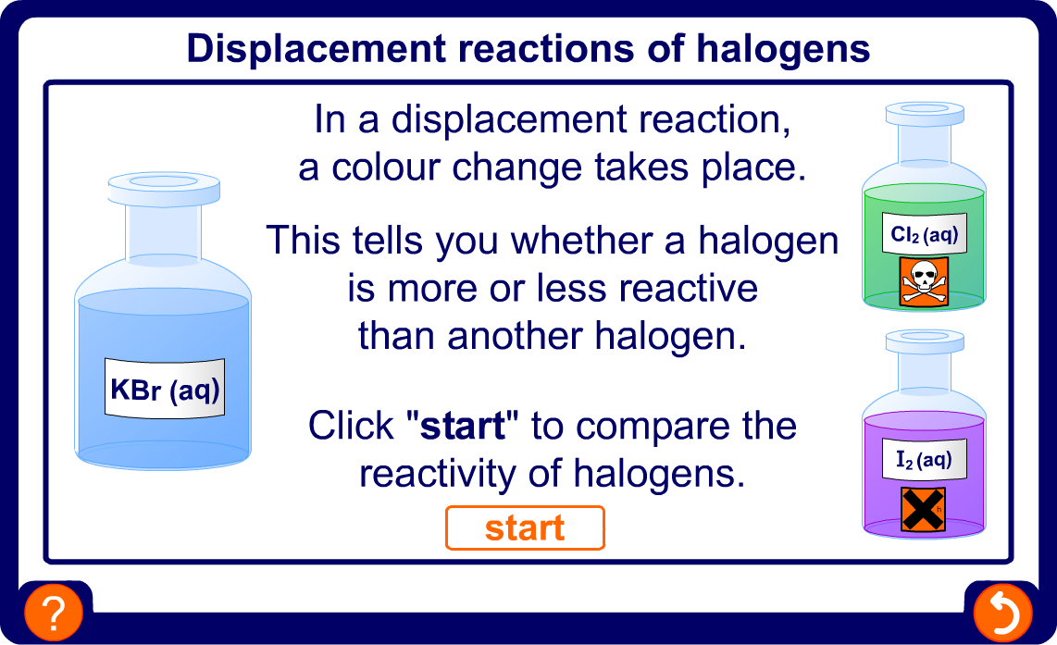
Displacement reactions of halogens

Slide 20
Displacement reactions: summary
The reactions between solutions of halogens and metal halides (salts) can be summarised in a table:
salt (aq)
potassium chloride
potassium bromide
potassium iodide
halogen
chlorine
X
2KCl + Br₂
2KCl + I₂
bromine
no reaction
X
2KBr + I₂
iodine
no reaction
no reaction
X

Slide 21
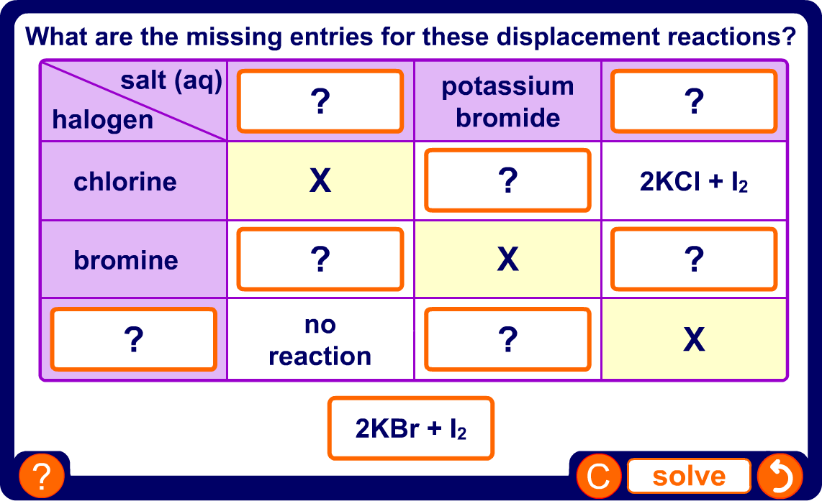

Slide 22
Reactions of halogens with metals
The reactivity of halogens means that they readily react with most metals.
Halogens need to gain electrons for a full electron shell and metals need to lose electrons for a full electron shell.
This means that halogens and metals react to form ionic compounds. These are metal halides, which are a type of salt.
Chlorine reacts vigorously with iron after gentle heating, despite iron’s low reactivity.
+
iron (III) chloride
chlorine
iron
➔
3Cl₂ (g)
+
2Fe (s)
➔
2FeCl₃ (s)

Slide 23
More reactions of halogens with metals
Bromine reacts steadily with iron when heated constantly.
+
iron (III) bromide
bromine
iron
➔
3Br₂ (g)
+
2Fe (s)
➔
2BrCl₃ (s)
Iodine reacts slowly with iron when heated constantly.
+
iron (III) iodide
iodine
iron
➔
3I₂ (g)
+
2Fe (s)
➔
2ICl₃ (s)

Slide 24
Reactions of halogens with non-metals
Halogens also react with non-metals.
For example, halogens react with hydrogen to create hydrogen halides.
hydrogen chloride
hydrogen
H
H
Cl
Cl
chlorine
Unlike their reactions with metals, halogens share electrons with non-metals, and so react to form covalent compounds.
All hydrogen halides are gases. They dissolve easily in water and become strong acids.

Slide 25
Uses

Slide 26
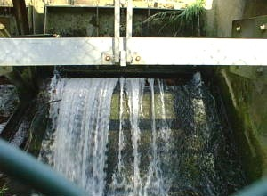

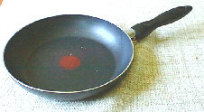
Uses of fluorine
Fluoridation of water, to prevent tooth decay
Toothpaste,
to prevent tooth decay
fluorine
and its
compounds
Polymers, e.g. Teflon for non-stick pans
Processing uranium nuclear fuel

Slide 27
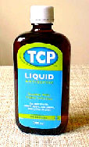
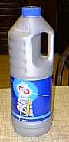
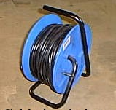
Uses of chlorine
Pesticides and weed killers
Treatment of drinking water
Antiseptics and disinfectants
chlorine
and its
compounds
Chlorinated carbon compounds, e.g. solvents and plastics (PVC)
Bleach to kill bacteria and to make paper white

Slide 28
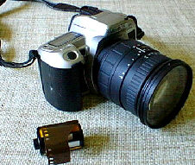
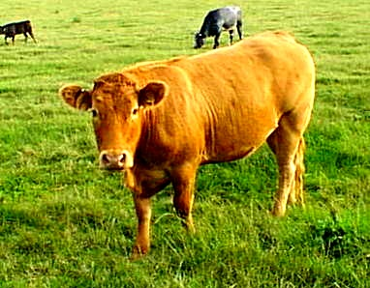
Uses of bromine and iodine
bromine
and its
compounds
Leaded petrol
Medicines
Photography
Agriculture
iodine
and its
compounds
Antiseptics and water purification tablets
Animal feed supplements

Slide 29
Summary activities

Slide 30
Glossary
diatomic – An element that exists as molecules containing two atoms covalently bonded.
displacement – The reaction when a more reactive halogen reacts with a compound containing a less reactive halogen.
halide – The name of a halogen when it has reacted with another substance and gained a full outer electron shell.
halogen – An element that belongs to group 7 of the periodic table.
hydrogen halide – A compound formed from the reaction between hydrogen and a halogen.
metal halide – A compound formed from the reaction between a metal and a halogen.
sublime – To change from a solid to a gas without first becoming a liquid.
volatile – A substance that evaporates or produces vapour
at relatively low temperature.

